Slide 1

PGA Golf
Case Study
Chaitanya Varma Mudundi
Goutham Bommu
Hemanchal Joshi
Jasmeet Singh
Jiye Wang
Saranjyot Singh

Slide 2
Introduction
PGA Tournament:
The data contains averages of different attributes like Total strokes, Average drive, percentage fairway, percentage GIR,put round etc. of players in PGA tournament.
An analysis has been done to answer the following questions:
Are scores different from the first day to the last day?
Are young people doing better than those who are older?
The techniques that are used to make the analysis are:
Indexing
Determining Confidence Intervals
Hypothesis testing
Z-test

Slide 3
Second Question 40
μ_{y} - μ_{o} | Difference Interval
Total Score | -1.49 | -0.05
Average Drive | 4.68 | 7.12
Percentage Fairway | -4.55 | -2.33
Percentage GIR | 0.82 | 2.44
Putt Round | -1.78 | -0.22
μ_{y}-μ_{o} = (x̅_{y}– x̅_{o}) ± Z√(S_{y}²/n_{y}+ S_{o}²/n_{o})
CI98% Z=2.33
x̅_{y}=283.18 S_{y}=4.00 n_{y}=192
x̅_{o}=283.95 S_{o}=5.41 n_{o}=68
μ_{y}-μ_{o} = (283.18–283.95) ± 2.33√(4.00²/192+ 5.41²/68)
=-0.77 ± 0.72
-1.49 < μ_{y}-μ_{o}< -0.05

Slide 4
Second Question 30

Slide 5
Second Question 50

Slide 6
Second Question 40
μ_{y} - μ_{o} | Difference Interval
Total Score | -5.28 | 3.74
Average Drive | -9.85 | 21.65
Percentage Fairway | -17.47 | 10.59
Percentage GIR | -4.83 | 8.09
Putt Round | -4.93 | 2.93
x̅_{y}=283.18 S_{y}=4.00 n_{y}=192
x̅_{o}=283.95 S_{o}=5.41 n_{o}=68
S_{p}² =((n_{y} -1) S_{y}²+(n_{o} -1) S_{o}²)/(n_{y} + n_{o} -2)
=((192-1)4²+(68-1)5.41²)/(192+68-2)=19.45
CI90% df=198+68-2=264
t_{.05,264} = 1.645
μ_{y}-μ_{o} = (x̅_{y}– x̅_{o}) ± t√(S_{p}² (1/n_{y}+ 1/n_{o}))
= (283.18–283.95) ± 1.645√(19.45²(1/192+ 1/68))
=-0.77 ± 4.51
-5.28 < μ_{y}-μ_{o}< 3.74

Slide 7


Introduction
PGA Tournament:
The data contains averages of different attributes like Total strokes, Average drive, percentage fairway, percentage GIR, put round etc. of players in PGA tournament.
An analysis has been done to answer the following questions:
Are scores different from the first day to the last day?
Are young people doing better than those who are older?
The techniques that are used to make the analysis are:
Indexing
Determining Confidence Intervals – Paired t test
Hypothesis testing
Z-test

Slide 8


DAY DIFFERENCE
Scores have increased while progressing through rounds.
We can witness on an average 2% percentage increase of scores from
round 1 to round 4.

Slide 9
(Round 4 – Round 1) scores​
DAY DIFFERENCE
(Round 4 – Round 1) scores
(Round 3 – Round 1) scores
(Round 4 – Round 3) scores
Mean | Median | Mode
1.554 | 1.458 | 0
Mean | Median | Mode
1.158 | 1 | 2
Mean | Median | Mode
0.396 | 0.5 | 1
CI - [1.26, 1.83] @α = 1%
CI - [0.87, 1.44] @α = 1%
CI - [0.11, 0.67] @α = 1%
99% confident that they made highest scores in Round 4 when compared to previous rounds.
Players performance got down as they progressed through rounds.

Slide 10
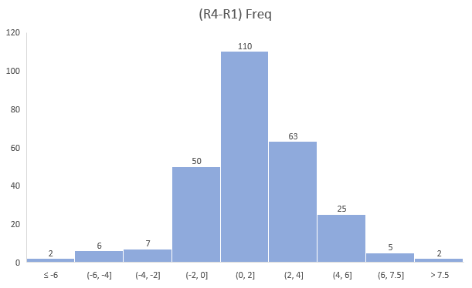
DAY DIFFERENCE
By comparing the Round 4 scores with Round 1

Slide 11


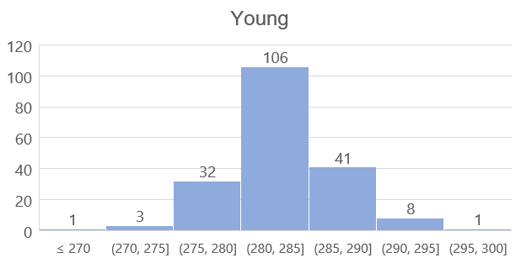
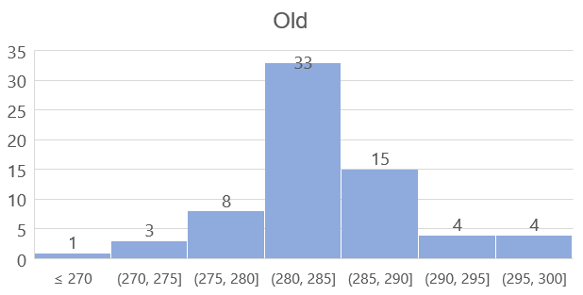
AGE DIFFERENCE
Take 40 as the age separation.
 | Total Strokes |  | Average Drive |  | Percentage Fairway |  | Percentage GIR |  | Putt Round
 | MEAN | STDEV | MEAN | STDEV | MEAN | STDEV | MEAN | STDEV | MEAN | STDEV
Young | 283.18 | 4.00 | 281.68 | 7.99 | 59.49 | 7.72 | 64.58 | 5.02 | 30.60 | 3.07
Old | 283.95 | 5.41↑ | 275.78 | 8.90↑ | 62.85 | 7.93↑ | 62.95 | 5.94↑ | 31.60 | 6.19↑

Slide 12
AGE DIFFERENCE
Take 40 as the age separation.
Identifying 98% confidence Interval for μ_{y}-μ_{o}
μ_{y}-μ_{o} = (x̅_{y}– x̅_{o}) ± Z√(S_{y}²/n_{y}+ S_{o}²/n_{o})
CI98% => Z=2.33
x̅_{y}=283.18 S_{y}=4.00 n_{y}=192
x̅_{o}=283.95 S_{o}=5.41 n_{o}=68
μ_{y}-μ_{o} = (283.18–283.95) ± 2.33√(4.00²/192+ 5.41²/68)
=-0.77 ± 0.72
-1.49 < μ_{y}-μ_{o}< -0.05
μ_{y} - μ_{o} | Difference Interval
Total Strokes | -1.49 | -0.05
Average Drive | 4.68 | 7.12
Percentage Fairway | -4.55 | -2.33
Percentage GIR | 0.82 | 2.44
Putt Round | -1.78 | -0.22

Slide 13
AGE DIFFERENCE
Take 30 as the age separation.
Take 35 as the age separation.
μ_{y} - μ_{o} | Difference Interval
Total Strokes | -0.50 | 0.72
Average Drive | 3.12 | 5.36
Percentage Fairway | -4.35 | -2.23
Percentage GIR | -0.76 | 0.64
Putt Round | -0.03 | 1.07
μ_{y} - μ_{o} | Difference Interval
Total Strokes | -1.09 | 0.01
Average Drive | 3.01 | 5.11
Percentage Fairway | -3.92 | -1.98
Percentage GIR | -0.25 | 1.09
Putt Round | -1.04 | 0.02

Slide 14
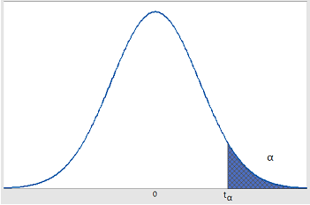
Hypothesis testing of means of samples
aged >= 40 and age < 40
Total strokes as metric of calculation.
Given data:
Alpha=0.05
DF=68-1=67
Young => Population mean y
Old =>population mean o
Hypotesis statement:
Ho : Pmean y=Pmean o
(performance is same)
H1 : Pmean y>pmean o
(young performed well than old)
Finding t value:
t=(x̅_{y}– x̅_{o}) – (μ_{y}-μ₀ ₎ /√(S_{y}²/n_{y}+ S_{o}²/n_{o})=
1.43
As t<alpha =>stay with null hypothesis.
Conclusion:
There is no perfect evidence to state that player who are young have performed well than old
1.43
1.67
Hypothesis test for difference of means

Slide 15

Thank You
Questions ?

